Slide 1

Words of the Week:
To Do:
Evaluations:
Notes:
1. Teacher Observation
2. Oral Response
3. Teacher Questions
4. Student Demonstration
5. Written Assignment
6. Student Participation
7. Quiz
8. Test

Slide 2
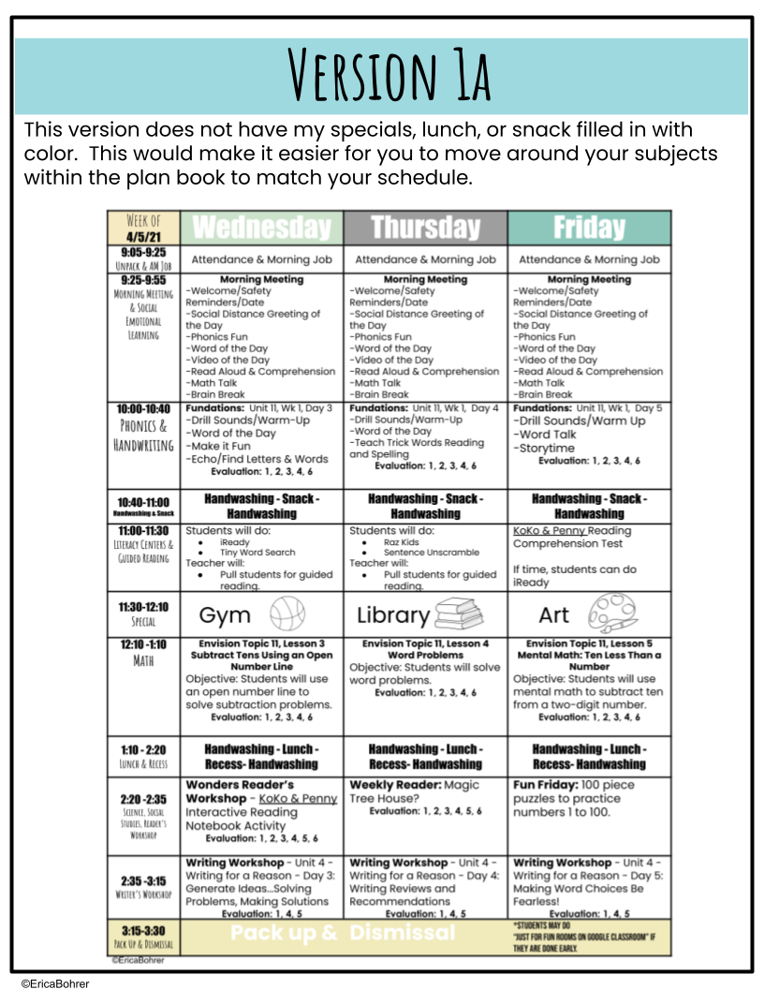

Slide 3






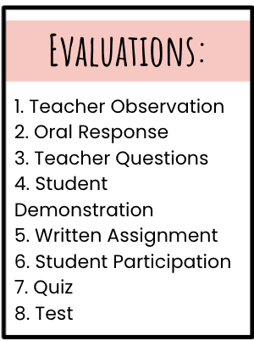
Mrs. Blasi
Week of 4/5/21 | Monday | Tuesday
9:05-9:25 Unpack & AM Job | Attendance & Morning Job | Attendance & Morning Job
9:25-9:55 Morning Meeting & Social Emotional Learning | Morning Meeting -Welcome/Safety Reminders/Date -Social Distance Greeting of the Day -Phonics Fun -Word of the Day -Video of the Day -Read Aloud & Comprehension -Math Talk -Brain Break | Morning Meeting -Welcome/Safety Reminders/Date -Social Distance Greeting of the Day -Phonics Fun -Word of the Day -Video of the Day -Read Aloud & Comprehension -Math Talk -Brain Break
10:00-10:40 Phonics & Handwriting | Fundations: Unit 11, Wk 1, Day 1 -Drill Sounds/Warm-Up -Introduce New Concepts Evaluation: 1, 2, 3, 4, 6 | Fundations: Unit 11, Wk 1, Day 2 -Drill Sounds/Warm-Up -Introduce New Concepts -Echo/Find Letters & Words -Dictation (Dry Erase) Evaluation: 1, 2, 3, 4, 6
10:40-11:00 Handwashing & Snack | Handwashing - Snack - Handwashing | Handwashing - Snack - Handwashing
11:00-11:30 Literacy Centers & Guided Reading | Students will do: iReady Spin a Word Teacher will: Pull students for guided reading. | Students will do: Raz Kids Word Search & Unscramble a Word Teacher will: Pull students for guided reading.
11:30-12:10 Special | Gym | Music
12:10 -1:10 Math | Envision Topic 11, Lesson 1 Subtract Tens Using Models Objective: Students will use models to subtract tens. Evaluation: 1, 2, 3, 4, 6 | Envision Topic 11, Lesson 2 Subtract Tens Using a Hundred Chart Objective: Students will use a hundred chart to subtract a multiple of 10 from another multiple of 10. Evaluation: 1, 2, 3, 4, 6
1:10 - 2:20 Lunch & Recess | Handwashing - Lunch - Recess- Handwashing | Handwashing - Lunch - Recess- Handwashing
2:20 -2:40 Science, Social Studies, Reader’s Workshop | Science- Mystery Box Lesson 1a -BOCES Evaluation: 1, 2, 3, 4, 6 | Science - Mystery Box Lesson 1b-BOCES Evaluation: 1, 2, 3, 4, 6
2:40 -3:15 Writer’s Workshop | Writing Workshop - Unit 4 - Writing for a Reason - Day 1: Explore Your Point of View Evaluation: 1, 4, 5 | Writing Workshop - Unit 4 - Writing for a Reason - Day 2: Generate Idea Lists Evaluation: 1, 4, 5
3:15-3:30 Pack Up & Dismissal | Pack up & | Dismissal
First Grade
Room 113
Notes
Grade Tests
Bumpy
Funny
Puppy
Penny
Sandy
Bunny
Key
Monkey
Would
Write
Near
found

Slide 4


Week of 4/5/21 | Wednesday | Thursday | Friday
9:05-9:25 Unpack & AM Job | Attendance & Morning Job | Attendance & Morning Job | Attendance & Morning Job
9:25-9:55 Morning Meeting & Social Emotional Learning | Morning Meeting -Welcome/Safety Reminders/Date -Social Distance Greeting of the Day -Phonics Fun -Word of the Day -Video of the Day -Read Aloud & Comprehension -Math Talk -Brain Break | Morning Meeting -Welcome/Safety Reminders/Date -Social Distance Greeting of the Day -Phonics Fun -Word of the Day -Video of the Day -Read Aloud & Comprehension -Math Talk -Brain Break | Morning Meeting -Welcome/Safety Reminders/Date -Social Distance Greeting of the Day -Phonics Fun -Word of the Day -Video of the Day -Read Aloud & Comprehension -Math Talk -Brain Break
10:00-10:40 Phonics & Handwriting | Fundations: Unit 11, Wk 1, Day 3 -Drill Sounds/Warm-Up -Word of the Day -Make it Fun -Echo/Find Letters & Words Evaluation: 1, 2, 3, 4, 6 | Fundations: Unit 11, Wk 1, Day 4 -Drill Sounds/Warm-Up -Word of the Day -Teach Trick Words Reading and Spelling Evaluation: 1, 2, 3, 4, 6 | Fundations: Unit 11, Wk 1, Day 5 -Drill Sounds/Warm Up -Word Talk -Storytime Evaluation: 1, 2, 3, 4, 6
10:40-11:00 Handwashing & Snack | Handwashing - Snack - Handwashing | Handwashing - Snack - Handwashing | Handwashing - Snack - Handwashing
11:00-11:30 Literacy Centers & Guided Reading | Students will do: iReady Tiny Word Search Teacher will: Pull students for guided reading. | Students will do: Raz Kids Sentence Unscramble Teacher will: Pull students for guided reading. | KoKo & Penny Reading Comprehension Test If time, students can do iReady
11:30-12:10 Special | Gym | Library | Art
12:10 -1:10 Math | Envision Topic 11, Lesson 3 Subtract Tens Using an Open Number Line Objective: Students will use an open number line to solve subtraction problems. Evaluation: 1, 2, 3, 4, 6 | Envision Topic 11, Lesson 4 Word Problems Objective: Students will solve word problems. Evaluation: 1, 2, 3, 4, 6 | Envision Topic 11, Lesson 5 Mental Math: Ten Less Than a Number Objective: Students will use mental math to subtract ten from a two-digit number. Evaluation: 1, 2, 3, 4, 6
1:10 - 2:20 Lunch & Recess | Handwashing - Lunch - Recess- Handwashing | Handwashing - Lunch - Recess- Handwashing | Handwashing - Lunch - Recess- Handwashing
2:20 -2:35 Science, Social Studies, Reader’s Workshop | Wonders Reader’s Workshop - KoKo & Penny Interactive Reading Notebook Activity Evaluation: 1, 2, 3, 4, 5, 6 | Weekly Reader: Magic Tree House? Evaluation: 1, 2, 3, 4, 5, 6 | Fun Friday: 100 piece puzzles to practice numbers 1 to 100.
2:35 -3:15 Writer’s Workshop | Writing Workshop - Unit 4 - Writing for a Reason - Day 3: Generate Ideas...Solving Problems, Making Solutions Evaluation: 1, 4, 5 | Writing Workshop - Unit 4 - Writing for a Reason - Day 4: Writing Reviews and Recommendations Evaluation: 1, 4, 5 | Writing Workshop - Unit 4 - Writing for a Reason - Day 5: Making Word Choices Be Fearless! Evaluation: 1, 4, 5
3:15-3:30 Pack Up & Dismissal | Pack up & | Dismissal | *Students may do “Just for Fun Rooms on Google Classroom” if they are done early.

Slide 5
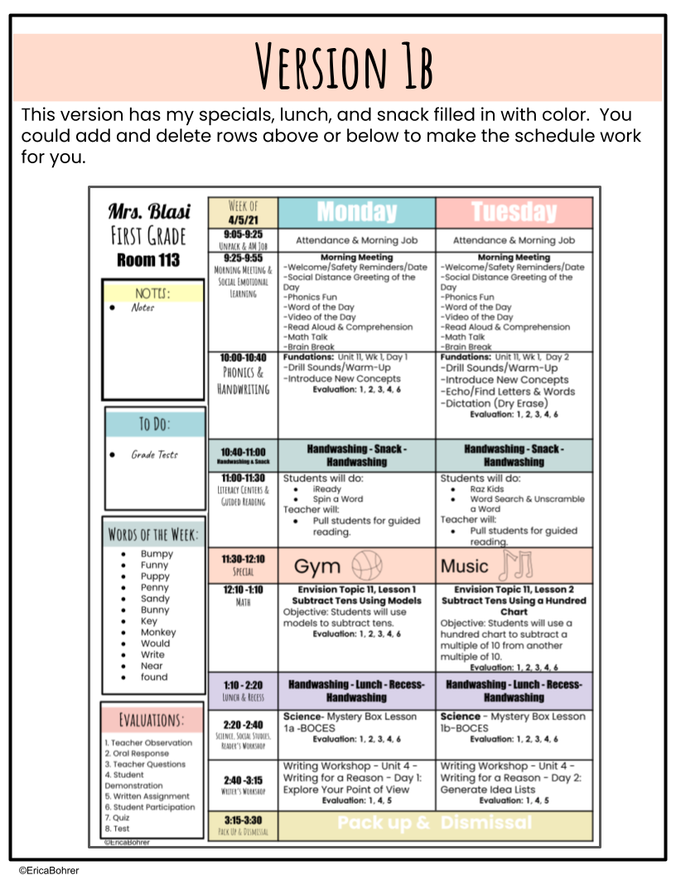

Slide 6
Mrs. Blasi
Week of 4/5/21 | Monday | Tuesday
9:05-9:25 Unpack & AM Job | Attendance & Morning Job | Attendance & Morning Job
9:25-9:55 Morning Meeting & Social Emotional Learning | Morning Meeting -Welcome/Safety Reminders/Date -Social Distance Greeting of the Day -Phonics Fun -Word of the Day -Video of the Day -Read Aloud & Comprehension -Math Talk -Brain Break | Morning Meeting -Welcome/Safety Reminders/Date -Social Distance Greeting of the Day -Phonics Fun -Word of the Day -Video of the Day -Read Aloud & Comprehension -Math Talk -Brain Break
10:00-10:40 Phonics & Handwriting | Fundations: Unit 11, Wk 1, Day 1 -Drill Sounds/Warm-Up -Introduce New Concepts Evaluation: 1, 2, 3, 4, 6 | Fundations: Unit 11, Wk 1, Day 2 -Drill Sounds/Warm-Up -Introduce New Concepts -Echo/Find Letters & Words -Dictation (Dry Erase) Evaluation: 1, 2, 3, 4, 6
10:40-11:00 Handwashing & Snack | Handwashing - Snack - Handwashing | Handwashing - Snack - Handwashing
11:00-11:30 Literacy Centers & Guided Reading | Students will do: iReady Spin a Word Teacher will: Pull students for guided reading. | Students will do: Raz Kids Word Search & Unscramble a Word Teacher will: Pull students for guided reading.
11:30-12:10 Special | Gym | Music
12:10 -1:10 Math | Envision Topic 11, Lesson 1 Subtract Tens Using Models Objective: Students will use models to subtract tens. Evaluation: 1, 2, 3, 4, 6 | Envision Topic 11, Lesson 2 Subtract Tens Using a Hundred Chart Objective: Students will use a hundred chart to subtract a multiple of 10 from another multiple of 10. Evaluation: 1, 2, 3, 4, 6
1:10 - 2:20 Lunch & Recess | Handwashing - Lunch - Recess- Handwashing | Handwashing - Lunch - Recess- Handwashing
2:20 -2:40 Science, Social Studies, Reader’s Workshop | Science- Mystery Box Lesson 1a -BOCES Evaluation: 1, 2, 3, 4, 6 | Science - Mystery Box Lesson 1b-BOCES Evaluation: 1, 2, 3, 4, 6
2:40 -3:15 Writer’s Workshop | Writing Workshop - Unit 4 - Writing for a Reason - Day 1: Explore Your Point of View Evaluation: 1, 4, 5 | Writing Workshop - Unit 4 - Writing for a Reason - Day 2: Generate Idea Lists Evaluation: 1, 4, 5
3:15-3:30 Pack Up & Dismissal | Pack up & | Dismissal
First Grade
Room 113
Notes
Grade Tests
Bumpy
Funny
Puppy
Penny
Sandy
Bunny
Key
Monkey
Would
Write
Near
found

Slide 7
Week of 4/5/21 | Wednesday | Thursday | Friday
9:05-9:25 Unpack & AM Job | Attendance & Morning Job | Attendance & Morning Job | Attendance & Morning Job
9:25-9:55 Morning Meeting & Social Emotional Learning | Morning Meeting -Welcome/Safety Reminders/Date -Social Distance Greeting of the Day -Phonics Fun -Word of the Day -Video of the Day -Read Aloud & Comprehension -Math Talk -Brain Break | Morning Meeting -Welcome/Safety Reminders/Date -Social Distance Greeting of the Day -Phonics Fun -Word of the Day -Video of the Day -Read Aloud & Comprehension -Math Talk -Brain Break | Morning Meeting -Welcome/Safety Reminders/Date -Social Distance Greeting of the Day -Phonics Fun -Word of the Day -Video of the Day -Read Aloud & Comprehension -Math Talk -Brain Break
10:00-10:40 Phonics & Handwriting | Fundations: Unit 11, Wk 1, Day 3 -Drill Sounds/Warm-Up -Word of the Day -Make it Fun -Echo/Find Letters & Words Evaluation: 1, 2, 3, 4, 6 | Fundations: Unit 11, Wk 1, Day 4 -Drill Sounds/Warm-Up -Word of the Day -Teach Trick Words Reading and Spelling Evaluation: 1, 2, 3, 4, 6 | Fundations: Unit 11, Wk 1, Day 5 -Drill Sounds/Warm Up -Word Talk -Storytime Evaluation: 1, 2, 3, 4, 6
10:40-11:00 Handwashing & Snack | Handwashing - Snack - Handwashing | Handwashing - Snack - Handwashing | Handwashing - Snack - Handwashing
11:00-11:30 Literacy Centers & Guided Reading | Students will do: iReady Tiny Word Search Teacher will: Pull students for guided reading. | Students will do: Raz Kids Sentence Unscramble Teacher will: Pull students for guided reading. | KoKo & Penny Reading Comprehension Test If time, students can do iReady
11:30-12:10 Special | Gym | Library | Art
12:10 -1:10 Math | Envision Topic 11, Lesson 3 Subtract Tens Using an Open Number Line Objective: Students will use an open number line to solve subtraction problems. Evaluation: 1, 2, 3, 4, 6 | Envision Topic 11, Lesson 4 Word Problems Objective: Students will solve word problems. Evaluation: 1, 2, 3, 4, 6 | Envision Topic 11, Lesson 5 Mental Math: Ten Less Than a Number Objective: Students will use mental math to subtract ten from a two-digit number. Evaluation: 1, 2, 3, 4, 6
1:10 - 2:20 Lunch & Recess | Handwashing - Lunch - Recess- Handwashing | Handwashing - Lunch - Recess- Handwashing | Handwashing - Lunch - Recess- Handwashing
2:20 -2:35 Science, Social Studies, Reader’s Workshop | Wonders Reader’s Workshop - KoKo & Penny Interactive Reading Notebook Activity Evaluation: 1, 2, 3, 4, 5, 6 | Weekly Reader: Magic Tree House? Evaluation: 1, 2, 3, 4, 5, 6 | Fun Friday: 100 piece puzzles to practice numbers 1 to 100.
2:35 -3:15 Writer’s Workshop | Writing Workshop - Unit 4 - Writing for a Reason - Day 3: Generate Ideas...Solving Problems, Making Solutions Evaluation: 1, 4, 5 | Writing Workshop - Unit 4 - Writing for a Reason - Day 4: Writing Reviews and Recommendations Evaluation: 1, 4, 5 | Writing Workshop - Unit 4 - Writing for a Reason - Day 5: Making Word Choices Be Fearless! Evaluation: 1, 4, 5
3:15-3:30 Pack Up & Dismissal | Pack up & | Dismissal | *Students may do “Just for Fun Rooms on Google Classroom” if they are done early.

Slide 8
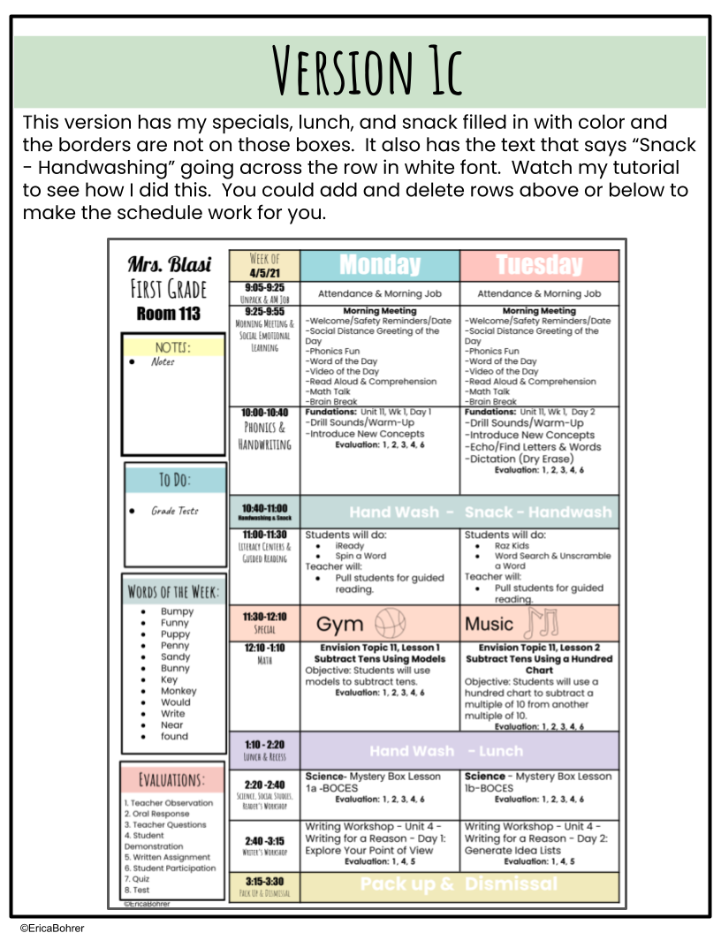

Slide 9
Mrs. Blasi
Week of 4/5 | Monday | Tuesday
9:05-9:25 Unpack & AM Job | Attendance & Morning Job | Attendance & Morning Job
9:25-9:55 Morning Meeting & Social Emotional Learning | Morning Meeting -Welcome/Safety Reminders/Date -Social Distance Greeting of the Day -Phonics Fun -Word of the Day -Video of the Day -Read Aloud & Comprehension -Math Talk -Brain Break | Morning Meeting -Welcome/Safety Reminders/Date -Social Distance Greeting of the Day -Phonics Fun -Word of the Day -Video of the Day -Read Aloud & Comprehension -Math Talk -Brain Break
10:00-10:40 Phonics & Handwriting | Fundations: Unit 11, Wk 1, Day 1 -Drill Sounds/Warm-Up -Introduce New Concepts Evaluation: 1, 2, 3, 4, 6 | Fundations: Unit 11, Wk 1, Day 2 -Drill Sounds/Warm-Up -Introduce New Concepts -Echo/Find Letters & Words -Dictation (Dry Erase) Evaluation: 1, 2, 3, 4, 6
10:40-11:00 Handwashing & Snack | Hand Wash - | Snack - Handwash
11:00-11:30 Literacy Centers & Guided Reading | Students will do: iReady Spin a Word Teacher will: Pull students for guided reading. | Students will do: Raz Kids Word Search & Unscramble a Word Teacher will: Pull students for guided reading.
11:30-12:10 Special | Gym | Music
12:10 -1:10 Math | Envision Topic 11, Lesson 1 Subtract Tens Using Models Objective: Students will use models to subtract tens. Evaluation: 1, 2, 3, 4, 6 | Envision Topic 11, Lesson 2 Subtract Tens Using a Hundred Chart Objective: Students will use a hundred chart to subtract a multiple of 10 from another multiple of 10. Evaluation: 1, 2, 3, 4, 6
1:10 - 2:20 Lunch & Recess | Hand Wash | - Lunch
2:20 -2:40 Science, Social Studies, Reader’s Workshop | Science- Mystery Box Lesson 1a -BOCES Evaluation: 1, 2, 3, 4, 6 | Science - Mystery Box Lesson 1b-BOCES Evaluation: 1, 2, 3, 4, 6
2:40 -3:15 Writer’s Workshop | Writing Workshop - Unit 4 - Writing for a Reason - Day 1: Explore Your Point of View Evaluation: 1, 4, 5 | Writing Workshop - Unit 4 - Writing for a Reason - Day 2: Generate Idea Lists Evaluation: 1, 4, 5
3:15-3:30 Pack Up & Dismissal | Pack up & | Dismissal
First Grade
Room 113
Notes
Grade Tests
Bumpy
Funny
Puppy
Penny
Sandy
Bunny
Key
Monkey
Would
Write
Near
found

Slide 10
Week of 4/5/21 | Wednesday | Thursday | Friday
9:05-9:25 Unpack & AM Job | Attendance & Morning Job | Attendance & Morning Job | Attendance & Morning Job
9:25-9:55 Morning Meeting & Social Emotional Learning | Morning Meeting -Welcome/Safety Reminders/Date -Social Distance Greeting of the Day -Phonics Fun -Word of the Day -Video of the Day -Read Aloud & Comprehension -Math Talk -Brain Break | Morning Meeting -Welcome/Safety Reminders/Date -Social Distance Greeting of the Day -Phonics Fun -Word of the Day -Video of the Day -Read Aloud & Comprehension -Math Talk -Brain Break | Morning Meeting -Welcome/Safety Reminders/Date -Social Distance Greeting of the Day -Phonics Fun -Word of the Day -Video of the Day -Read Aloud & Comprehension -Math Talk -Brain Break
10:00-10:40 Phonics & Handwriting | Fundations: Unit 11, Wk 1, Day 3 -Drill Sounds/Warm-Up -Word of the Day -Make it Fun -Echo/Find Letters & Words Evaluation: 1, 2, 3, 4, 6 | Fundations: Unit 11, Wk 1, Day 4 -Drill Sounds/Warm-Up -Word of the Day -Teach Trick Words Reading and Spelling Evaluation: 1, 2, 3, 4, 6 | Fundations: Unit 11, Wk 1, Day 5 -Drill Sounds/Warm Up -Word Talk -Storytime Evaluation: 1, 2, 3, 4, 6
10:40-11:00 Handwashing & Snack | Hand Wash - | Snack | -Hand Wash
11:00-11:30 Literacy Centers & Guided Reading | Students will do: iReady Tiny Word Search Teacher will: Pull students for guided reading. | Students will do: Raz Kids Sentence Unscramble Teacher will: Pull students for guided reading. | KoKo & Penny Reading Comprehension Test If time, students can do iReady
11:30-12:10 Special | Gym | Library | Art
12:10 -1:10 Math | Envision Topic 11, Lesson 3 Subtract Tens Using an Open Number Line Objective: Students will use an open number line to solve subtraction problems. Evaluation: 1, 2, 3, 4, 6 | Envision Topic 11, Lesson 4 Word Problems Objective: Students will solve word problems. Evaluation: 1, 2, 3, 4, 6 | Envision Topic 11, Lesson 5 Mental Math: Ten Less Than a Number Objective: Students will use mental math to subtract ten from a two-digit number. Evaluation: 1, 2, 3, 4, 6
1:10 - 2:20 Lunch & Recess | Hand Wash - | Lunch | -Hand Wash
2:20 -2:35 Science, Social Studies, Reader’s Workshop | Wonders Reader’s Workshop - KoKo & Penny Interactive Reading Notebook Activity Evaluation: 1, 2, 3, 4, 5, 6 | Weekly Reader: Magic Tree House? Evaluation: 1, 2, 3, 4, 5, 6 | Fun Friday: 100 piece puzzles to practice numbers 1 to 100.
2:35 -3:15 Writer’s Workshop | Writing Workshop - Unit 4 - Writing for a Reason - Day 3: Generate Ideas...Solving Problems, Making Solutions Evaluation: 1, 4, 5 | Writing Workshop - Unit 4 - Writing for a Reason - Day 4: Writing Reviews and Recommendations Evaluation: 1, 4, 5 | Writing Workshop - Unit 4 - Writing for a Reason - Day 5: Making Word Choices Be Fearless! Evaluation: 1, 4, 5
3:15-3:30 Pack Up & Dismissal | Pack up & | Dismissal | *Students may do “Just for Fun Rooms on Google Classroom” if they are done early.

Slide 11
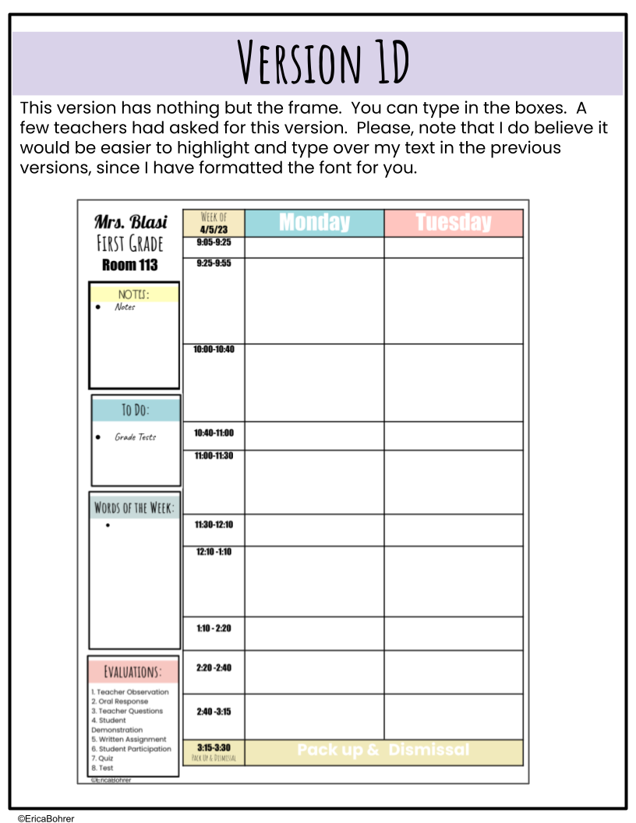

Slide 12
Mrs. Blasi
Week of 4/5/23 | Monday | Tuesday
9:05-9:25
9:25-9:55
10:00-10:40
10:40-11:00
11:00-11:30
11:30-12:10
12:10 -1:10
1:10 - 2:20
2:20 -2:40
2:40 -3:15
3:15-3:30 Pack Up & Dismissal | Pack up & | Dismissal
First Grade
Room 113
Notes
Grade Tests

Slide 13
Week of 4/5/23 | Wednesday | Thursday | Friday
9:05-9:25
9:25-9:55
10:00-10:40
10:40-11:00
11:00-11:30
11:30-12:10
12:10 -1:10
1:10 - 2:20
2:20 -2:35
2:35 -3:15
3:15-3:30 Pack Up & Dismissal | Pack up & | Dismissal

Slide 14
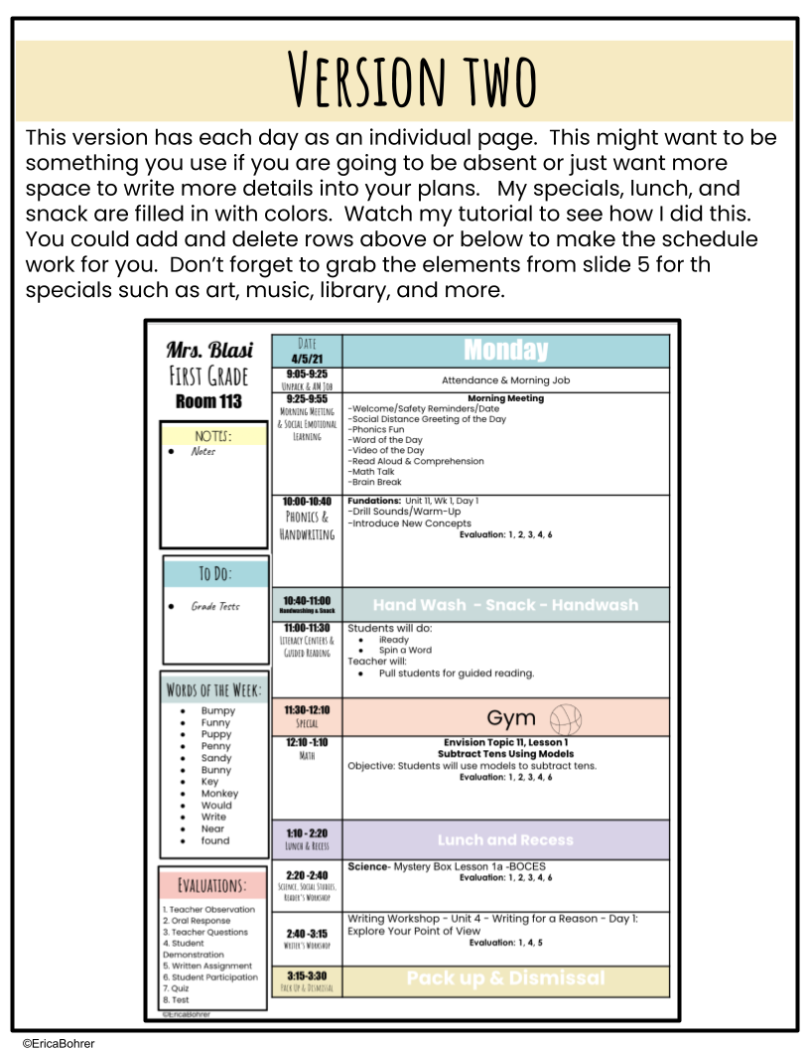

Slide 15
Mrs. Blasi
Date 4/5 | Monday
9:05-9:25 Unpack & AM Job | Attendance & Morning Job
9:25-9:55 Morning Meeting & Social Emotional Learning | Morning Meeting -Welcome/Safety Reminders/Date -Social Distance Greeting of the Day -Phonics Fun -Word of the Day -Video of the Day -Read Aloud & Comprehension -Math Talk -Brain Break
10:00-10:40 Phonics & Handwriting | Fundations: Unit 11, Wk 1, Day 1 -Drill Sounds/Warm-Up -Introduce New Concepts Evaluation: 1, 2, 3, 4, 6
10:40-11:00 Handwashing & Snack | Hand Wash - Snack - Handwash
11:00-11:30 Literacy Centers & Guided Reading | Students will do: iReady Spin a Word Teacher will: Pull students for guided reading.
11:30-12:10 Special | Gym
12:10 -1:10 Math | Envision Topic 11, Lesson 1 Subtract Tens Using Models Objective: Students will use models to subtract tens. Evaluation: 1, 2, 3, 4, 6
1:10 - 2:20 Lunch & Recess | Lunch and Recess
2:20 -2:40 Science, Social Studies, Reader’s Workshop | Science- Mystery Box Lesson 1a -BOCES Evaluation: 1, 2, 3, 4, 6
2:40 -3:15 Writer’s Workshop | Writing Workshop - Unit 4 - Writing for a Reason - Day 1: Explore Your Point of View Evaluation: 1, 4, 5
3:15-3:30 Pack Up & Dismissal | Pack up & Dismissal
First Grade
Room 113
Notes
Grade Tests
Bumpy
Funny
Puppy
Penny
Sandy
Bunny
Key
Monkey
Would
Write
Near
found

Slide 16
Mrs. Blasi
Date 4/5/21 | Tuesday
9:05-9:25 Unpack & AM Job | Attendance & Morning Job
9:25-9:55 Morning Meeting & Social Emotional Learning | Morning Meeting -Welcome/Safety Reminders/Date -Social Distance Greeting of the Day -Phonics Fun -Word of the Day -Video of the Day -Read Aloud & Comprehension -Math Talk -Brain Break
10:00-10:40 Phonics & Handwriting | Fundations: Unit 11, Wk 1, Day 1 -Drill Sounds/Warm-Up -Introduce New Concepts Evaluation: 1, 2, 3, 4, 6
10:40-11:00 Handwashing & Snack | Hand Wash - Snack - Handwash
11:00-11:30 Literacy Centers & Guided Reading | Students will do: iReady Spin a Word Teacher will: Pull students for guided reading.
11:30-12:10 Special | Gym
12:10 -1:10 Math | Envision Topic 11, Lesson 1 Subtract Tens Using Models Objective: Students will use models to subtract tens. Evaluation: 1, 2, 3, 4, 6
1:10 - 2:20 Lunch & Recess | Lunch and Recess
2:20 -2:40 Science, Social Studies, Reader’s Workshop | Science- Mystery Box Lesson 1a -BOCES Evaluation: 1, 2, 3, 4, 6
2:40 -3:15 Writer’s Workshop | Writing Workshop - Unit 4 - Writing for a Reason - Day 1: Explore Your Point of View Evaluation: 1, 4, 5
3:15-3:30 Pack Up & Dismissal | Pack up & Dismissal
First Grade
Room 113
Notes
Grade Tests
Bumpy
Funny
Puppy
Penny
Sandy
Bunny
Key
Monkey
Would
Write
Near
found

Slide 17
Mrs. Blasi
Date 4/5/21 | Wednesday
9:05-9:25 Unpack & AM Job | Attendance & Morning Job
9:25-9:55 Morning Meeting & Social Emotional Learning | Morning Meeting -Welcome/Safety Reminders/Date -Social Distance Greeting of the Day -Phonics Fun -Word of the Day -Video of the Day -Read Aloud & Comprehension -Math Talk -Brain Break
10:00-10:40 Phonics & Handwriting | Fundations: Unit 11, Wk 1, Day 1 -Drill Sounds/Warm-Up -Introduce New Concepts Evaluation: 1, 2, 3, 4, 6
10:40-11:00 Handwashing & Snack | Hand Wash - Snack - Handwash
11:00-11:30 Literacy Centers & Guided Reading | Students will do: iReady Spin a Word Teacher will: Pull students for guided reading.
11:30-12:10 Special | Gym
12:10 -1:10 Math | Envision Topic 11, Lesson 1 Subtract Tens Using Models Objective: Students will use models to subtract tens. Evaluation: 1, 2, 3, 4, 6
1:10 - 2:20 Lunch & Recess | Lunch and Recess
2:20 -2:40 Science, Social Studies, Reader’s Workshop | Science- Mystery Box Lesson 1a -BOCES Evaluation: 1, 2, 3, 4, 6
2:40 -3:15 Writer’s Workshop | Writing Workshop - Unit 4 - Writing for a Reason - Day 1: Explore Your Point of View Evaluation: 1, 4, 5
3:15-3:30 Pack Up & Dismissal | Pack up & Dismissal
First Grade
Room 113
Notes
Grade Tests
Bumpy
Funny
Puppy
Penny
Sandy
Bunny
Key
Monkey
Would
Write
Near
found

Slide 18
Mrs. Blasi
Date 4/5/21 | Thursday
9:05-9:25 Unpack & AM Job | Attendance & Morning Job
9:25-9:55 Morning Meeting & Social Emotional Learning | Morning Meeting -Welcome/Safety Reminders/Date -Social Distance Greeting of the Day -Phonics Fun -Word of the Day -Video of the Day -Read Aloud & Comprehension -Math Talk -Brain Break
10:00-10:40 Phonics & Handwriting | Fundations: Unit 11, Wk 1, Day 1 -Drill Sounds/Warm-Up -Introduce New Concepts Evaluation: 1, 2, 3, 4, 6
10:40-11:00 Handwashing & Snack | Hand Wash - Snack - Handwash
11:00-11:30 Literacy Centers & Guided Reading | Students will do: iReady Spin a Word Teacher will: Pull students for guided reading.
11:30-12:10 Special | Gym
12:10 -1:10 Math | Envision Topic 11, Lesson 1 Subtract Tens Using Models Objective: Students will use models to subtract tens. Evaluation: 1, 2, 3, 4, 6
1:10 - 2:20 Lunch & Recess | Lunch and Recess
2:20 -2:40 Science, Social Studies, Reader’s Workshop | Science- Mystery Box Lesson 1a -BOCES Evaluation: 1, 2, 3, 4, 6
2:40 -3:15 Writer’s Workshop | Writing Workshop - Unit 4 - Writing for a Reason - Day 1: Explore Your Point of View Evaluation: 1, 4, 5
3:15-3:30 Pack Up & Dismissal | Pack up & Dismissal
First Grade
Room 113
Notes
Grade Tests
Bumpy
Funny
Puppy
Penny
Sandy
Bunny
Key
Monkey
Would
Write
Near
found

Slide 19
Mrs. Blasi
Date 4/5/21 | Friday
9:05-9:25 Unpack & AM Job | Attendance & Morning Job
9:25-9:55 Morning Meeting & Social Emotional Learning | Morning Meeting -Welcome/Safety Reminders/Date -Social Distance Greeting of the Day -Phonics Fun -Word of the Day -Video of the Day -Read Aloud & Comprehension -Math Talk -Brain Break
10:00-10:40 Phonics & Handwriting | Fundations: Unit 11, Wk 1, Day 1 -Drill Sounds/Warm-Up -Introduce New Concepts Evaluation: 1, 2, 3, 4, 6
10:40-11:00 Handwashing & Snack | Hand Wash - Snack - Handwash
11:00-11:30 Literacy Centers & Guided Reading | Students will do: iReady Spin a Word Teacher will: Pull students for guided reading.
11:30-12:10 Special | Gym
12:10 -1:10 Math | Envision Topic 11, Lesson 1 Subtract Tens Using Models Objective: Students will use models to subtract tens. Evaluation: 1, 2, 3, 4, 6
1:10 - 2:20 Lunch & Recess | Lunch and Recess
2:20 -2:40 Science, Social Studies, Reader’s Workshop | Science- Mystery Box Lesson 1a -BOCES Evaluation: 1, 2, 3, 4, 6
2:40 -3:15 Writer’s Workshop | Writing Workshop - Unit 4 - Writing for a Reason - Day 1: Explore Your Point of View Evaluation: 1, 4, 5
3:15-3:30 Pack Up & Dismissal | Pack up & Dismissal
First Grade
Room 113
Notes
Grade Tests
Bumpy
Funny
Puppy
Penny
Sandy
Bunny
Key
Monkey
Would
Write
Near
found

Slide 20
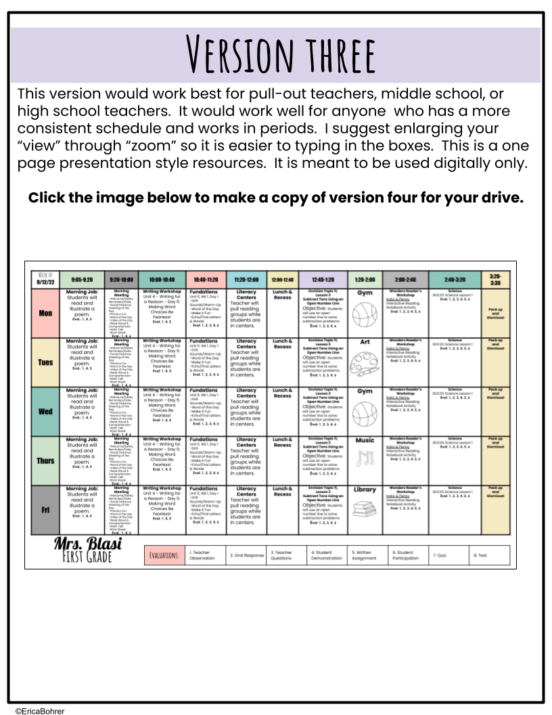

Slide 21
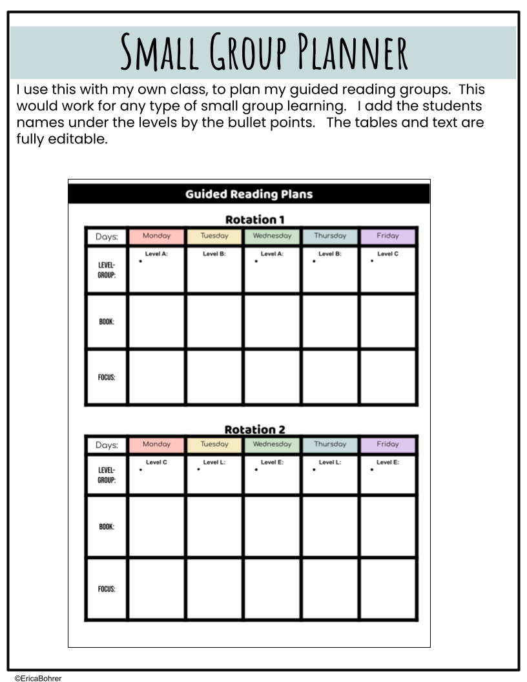

Slide 22
Guided Reading Plans
Rotation 1
Days: | Monday | Tuesday | Wednesday | Thursday | Friday
Level- Group: | Level A: | Level B: | Level A: | Level B: | Level C
Book:
Focus:
Rotation 2
Days: | Monday | Tuesday | Wednesday | Thursday | Friday
Level- Group: | Level C | Level L: | Level E: | Level L: | Level E:
Book:
Focus:

Slide 23
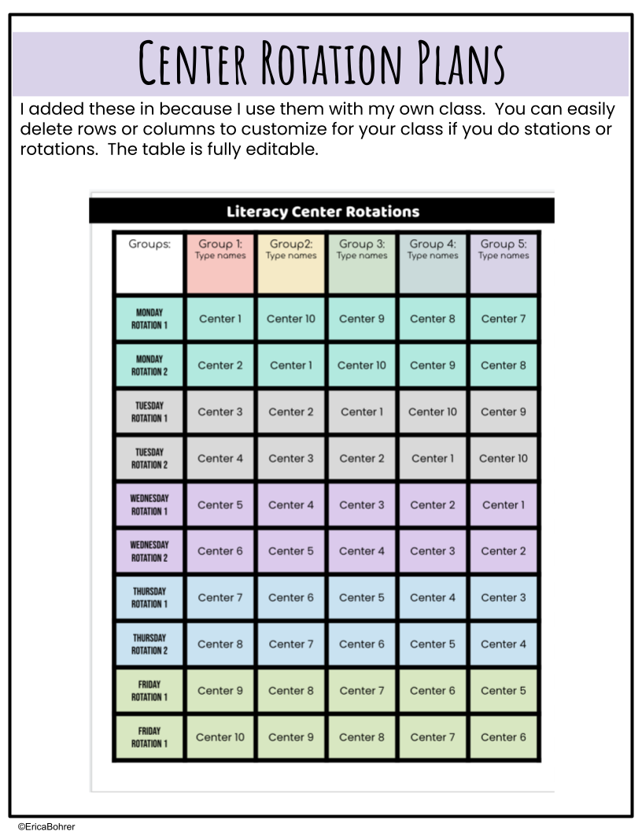

Slide 24
Literacy Center Rotations
Groups: | Group 1: Type names | Group2: Type names | Group 3: Type names | Group 4: Type names | Group 5: Type names
Monday Rotation 1 | Center 1 | Center 10 | Center 9 | Center 8 | Center 7
Monday Rotation 2 | Center 2 | Center 1 | Center 10 | Center 9 | Center 8
Tuesday Rotation 1 | Center 3 | Center 2 | Center 1 | Center 10 | Center 9
Tuesday Rotation 2 | Center 4 | Center 3 | Center 2 | Center 1 | Center 10
Wednesday Rotation 1 | Center 5 | Center 4 | Center 3 | Center 2 | Center 1
Wednesday Rotation 2 | Center 6 | Center 5 | Center 4 | Center 3 | Center 2
Thursday Rotation 1 | Center 7 | Center 6 | Center 5 | Center 4 | Center 3
Thursday Rotation 2 | Center 8 | Center 7 | Center 6 | Center 5 | Center 4
Friday Rotation 1 | Center 9 | Center 8 | Center 7 | Center 6 | Center 5
Friday Rotation 1 | Center 10 | Center 9 | Center 8 | Center 7 | Center 6

Slide 25
Literacy Center Rotations
Groups: | Group 1: Type names | Group2: Type names | Group 3: Type names | Group 4: Type names | Group 5: Type names
Monday Rotation 1 | Search/Read/Write the Room | Build a Word | Word Sort | Buddy Reading | iReady
Monday Rotation 2 | Listening Center | Search/Read/Write the Room | Build a Word | Word Sort | Budding Reading
Tuesday Rotation 1 | Match It | Listening Center | Search/Read/Write the Room | Build a Word | Word Sort
Tuesday Rotation 2 | Raz Kids | Match It | Listening Center | Search/Read/Write the Room | Build a Word
Wednesday Rotation 1 | Build a Sentence | Raz Kids | Match It | Listening Center | Search/Read/Write the Room
Wednesday Rotation 2 | Tiny Word Search | Build a Sentence | Raz Kids | Match It | Listening Center
Thursday Rotation 1 | iReady | Tiny Word Search | Build a Sentence | Raz Kids | Match It
Thursday Rotation 2 | Buddy Reading | iReady | Tiny Word Search | Build a Sentence | Raz Kids
Friday Rotation 1 | Word Sort | Buddy Reading | iReady | Tiny Word Search | Build a Sentence
Friday Rotation 1 | Build a Word | Word Sort | Buddy Reading | iReady | Tiny Word Search

Slide 26
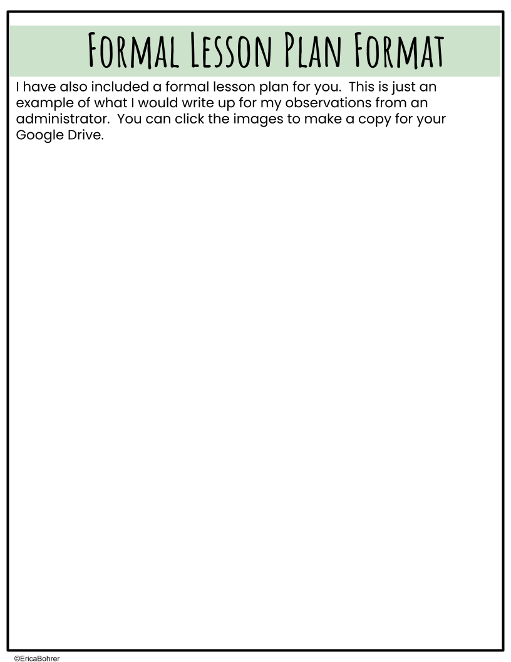
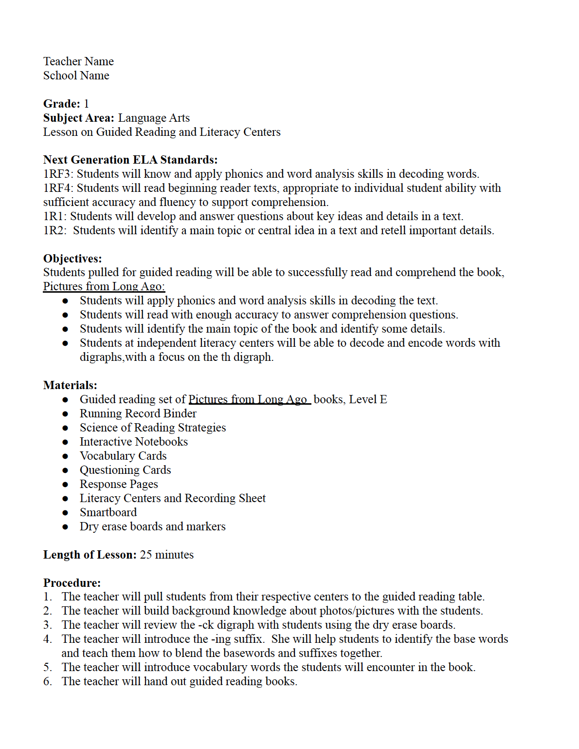
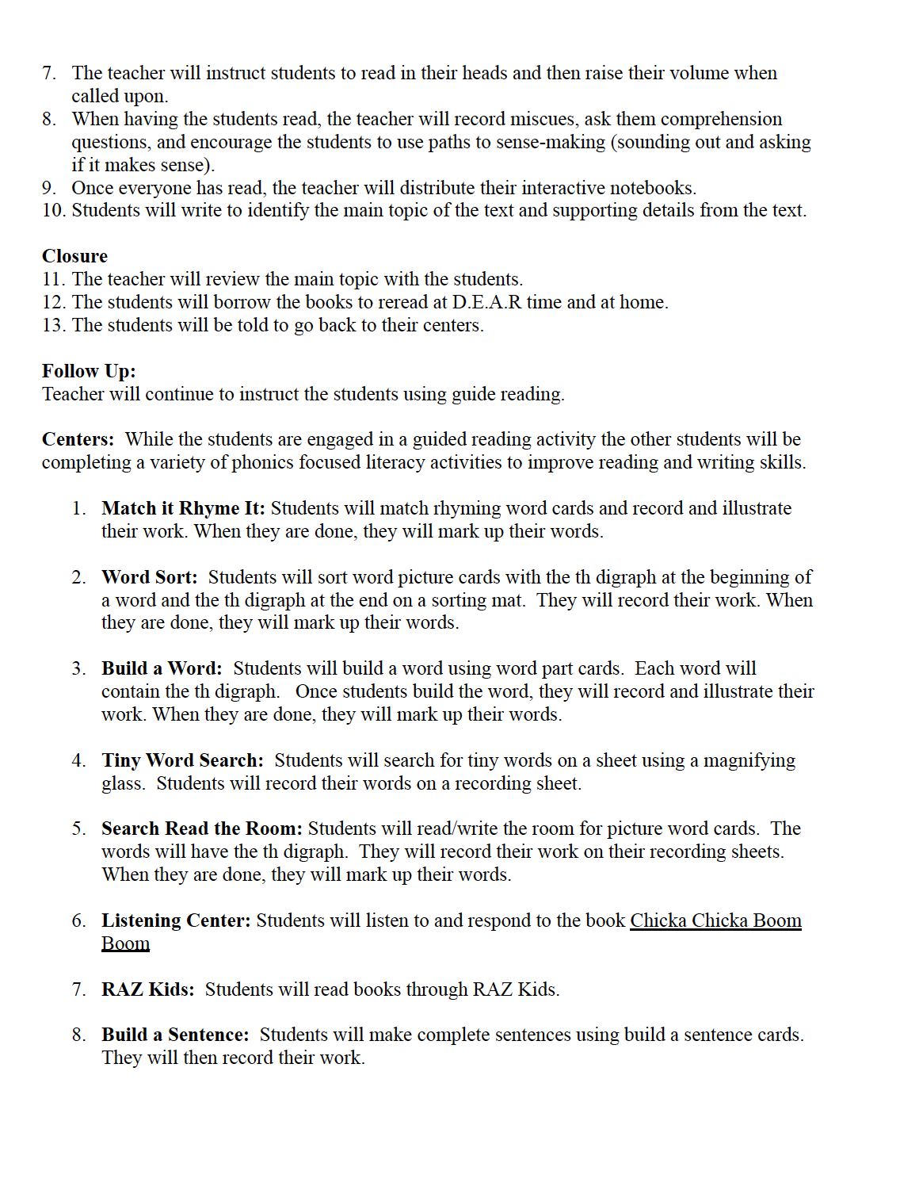

Slide 27
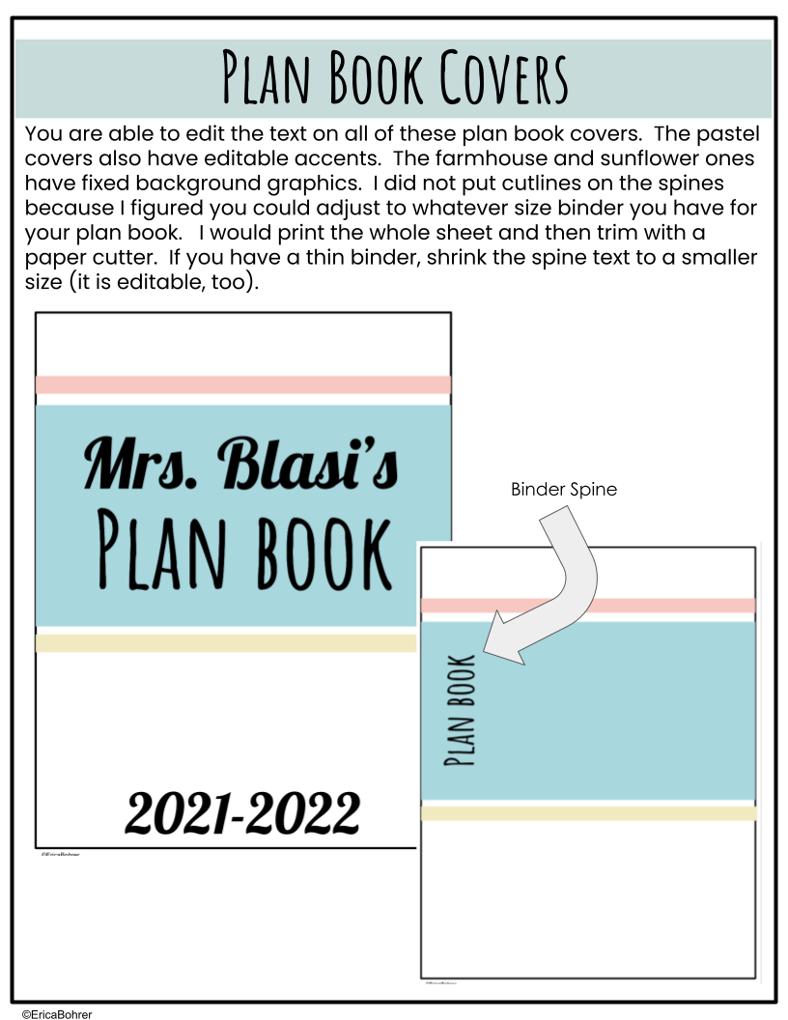
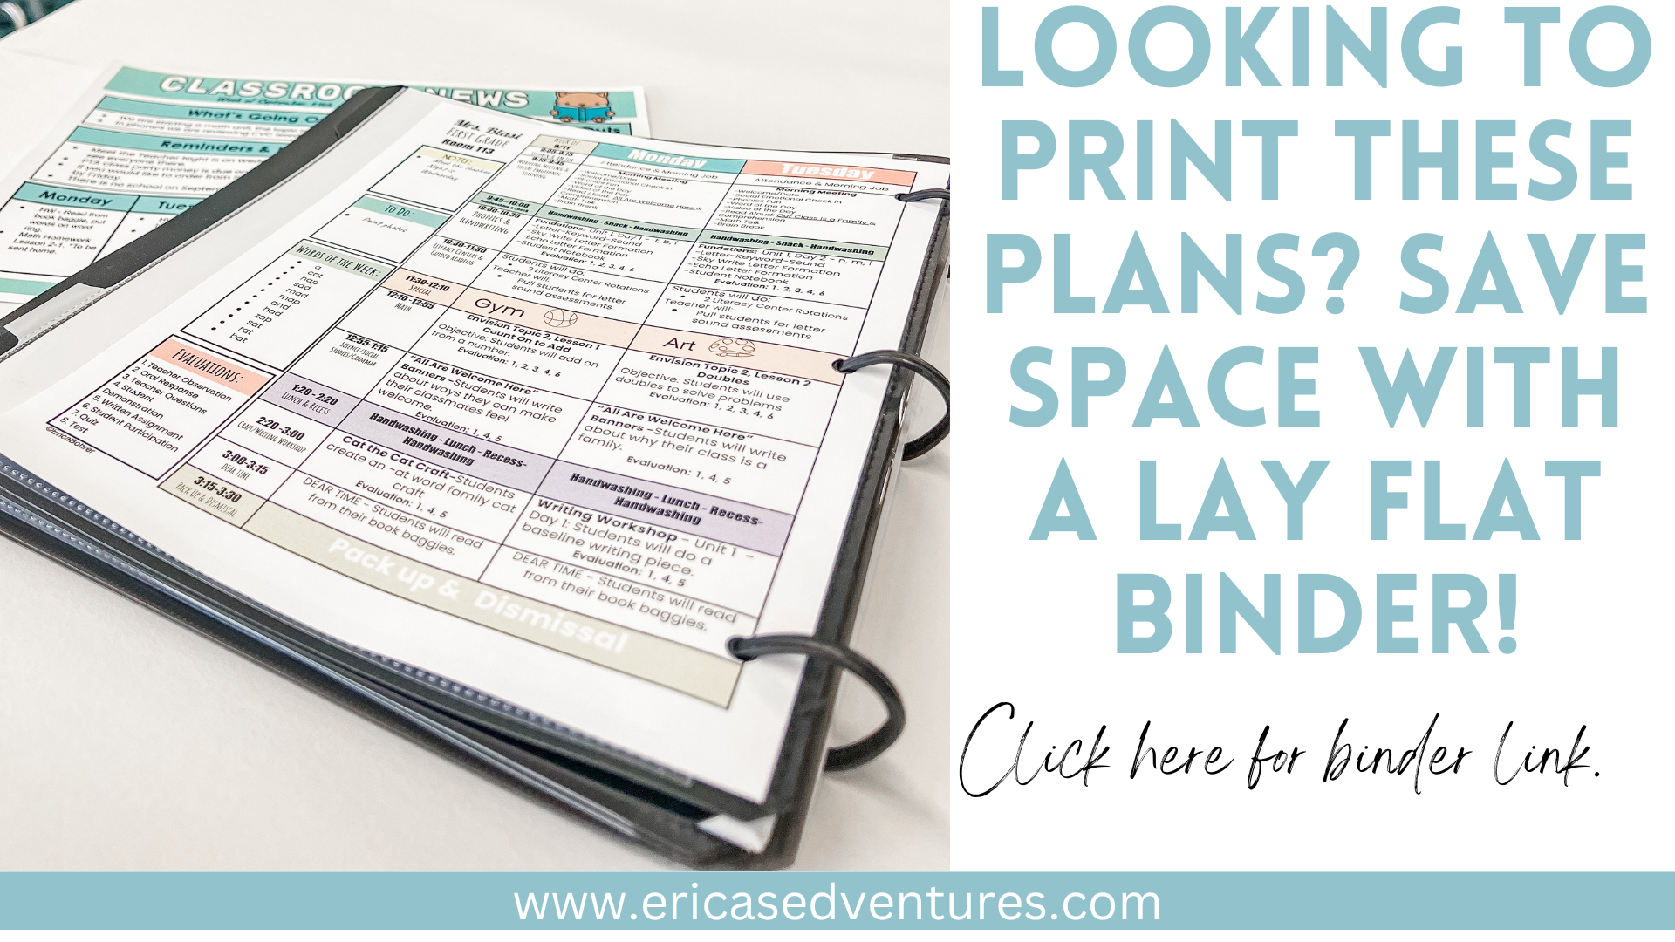

Slide 28
Mrs. Blasi’s
Plan book
2024-2025
©EricaBohrer

Slide 29
Plan book
©EricaBohrer

Slide 30
Mrs. Blasi’s
Plan book
1st Grade

Slide 31
Plan book
©EricaBohrer

Slide 32

Mrs. Blasi’s
Plan book
2024-2025
©EricaBohrer

Slide 33

Plan book
©EricaBohrer

Slide 34

Mrs. Blasi’s
Plan book
2024-2025

Slide 35

Plan book
©EricaBohrer

Slide 36

Lesson Plan
Book
Mrs. X
2024-2025

Slide 37
Plan Book

Slide 38

Teacher’s
Plan book
Mrs. X
2024-2025

Slide 39
Plan Book

Slide 40

Teacher’s
Plan book
Mrs. X
2024-2025

Slide 41
PlAn Book

Slide 42

Ms. X’s
Plan book
2024-2025

Slide 43

Ms. X’s
Plan Book
2024-2025

Slide 44

Ms. X’s
Plan Book
2024-2025
Room xxx

Slide 45

Plan Book
Plan Book
Plan book

