Slide 1

Created by Brigitte Vang
Lead Behavior Technician ☺

Slide 2





Good Morning Song

Slide 3

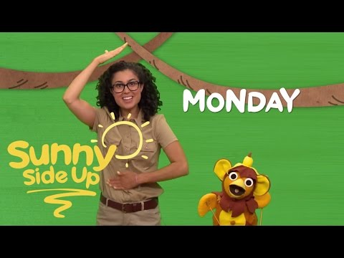

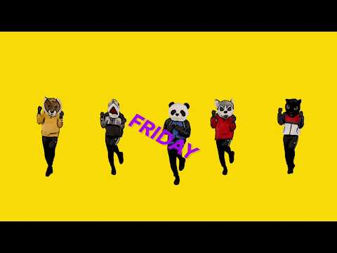
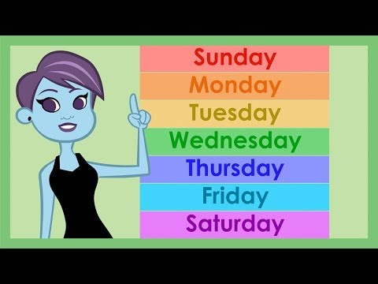
Days of the week

Slide 4


Slide 5

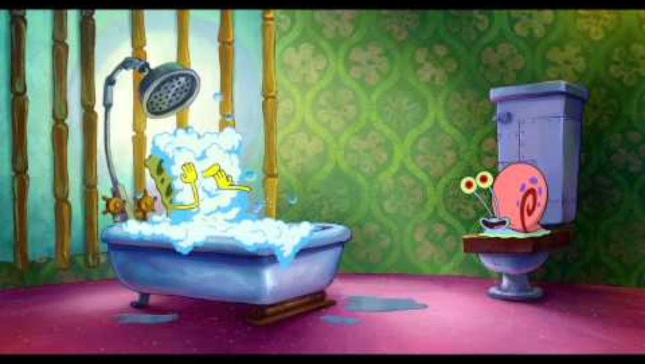







What Day is it?

Slide 6


Slide 7


Slide 8


Slide 9


Slide 10


Slide 11
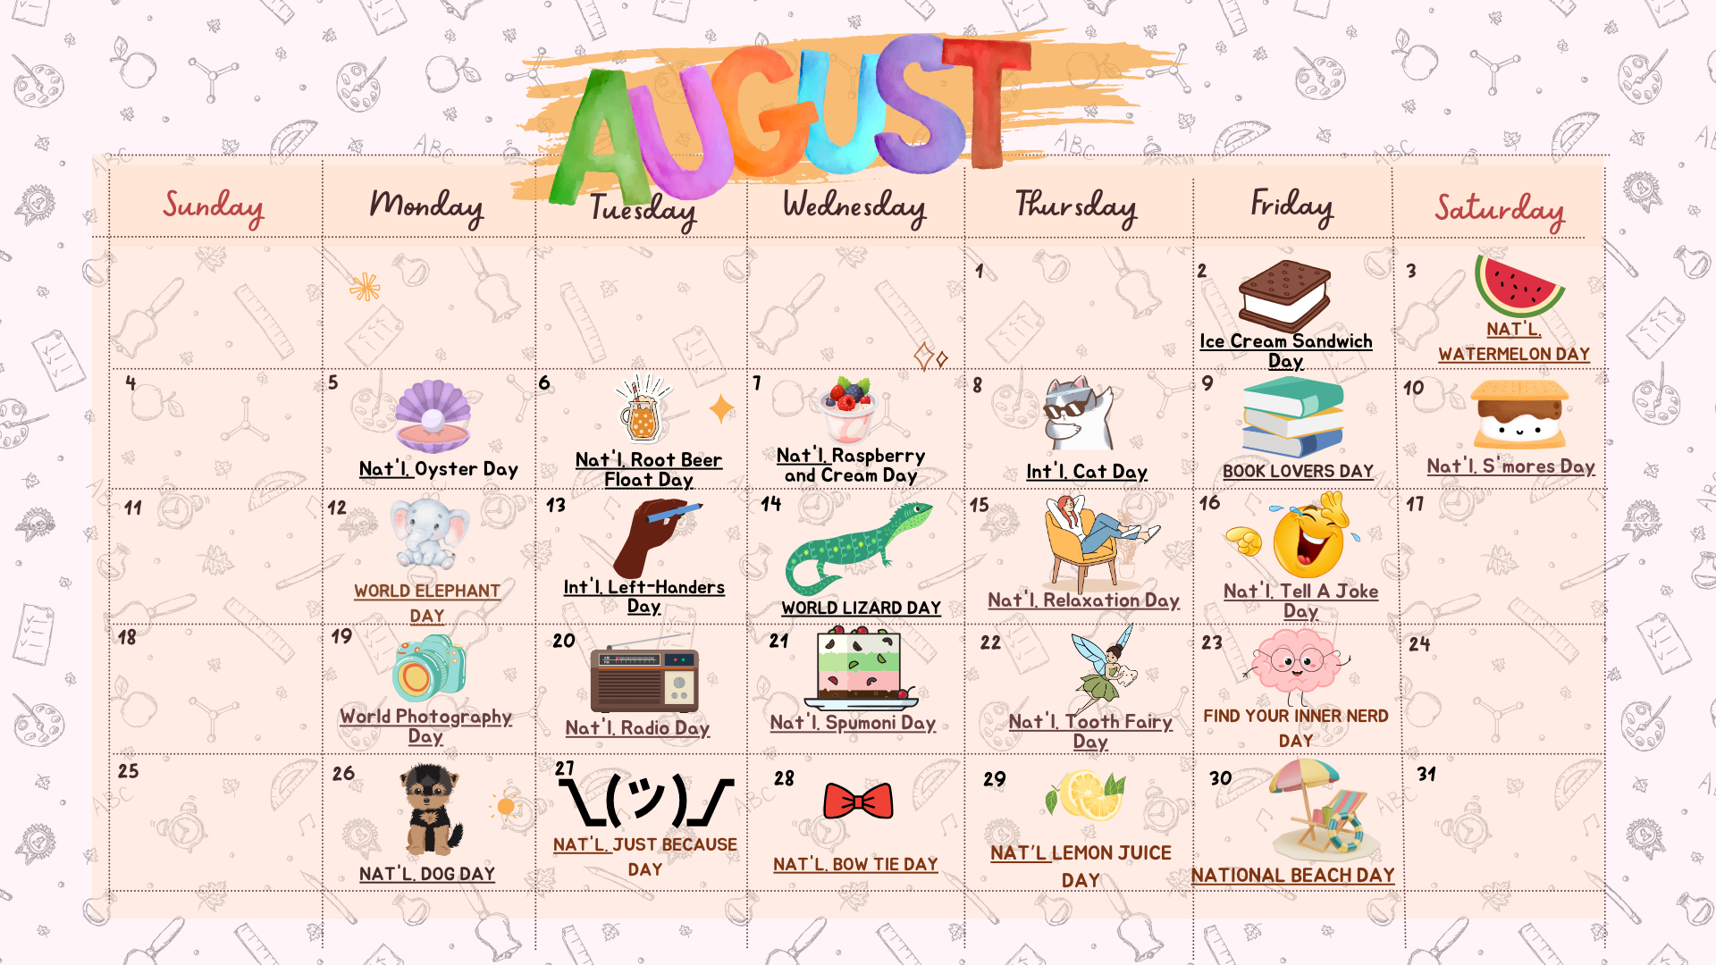

Slide 12

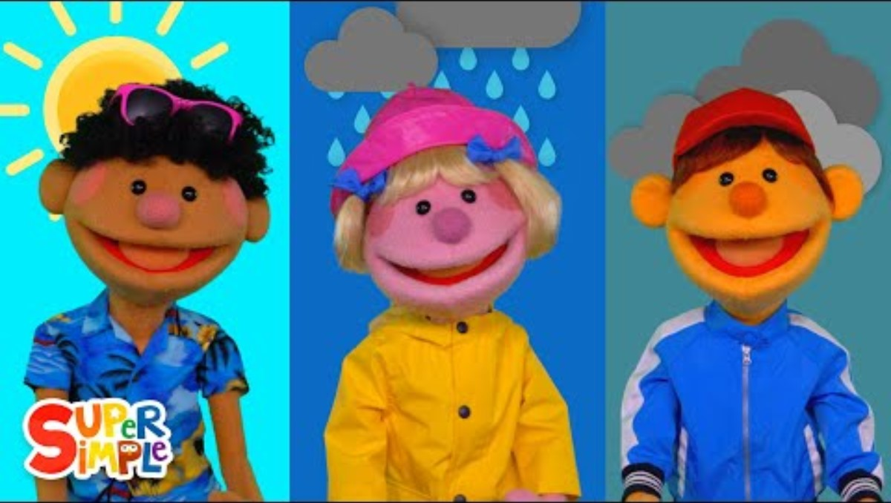
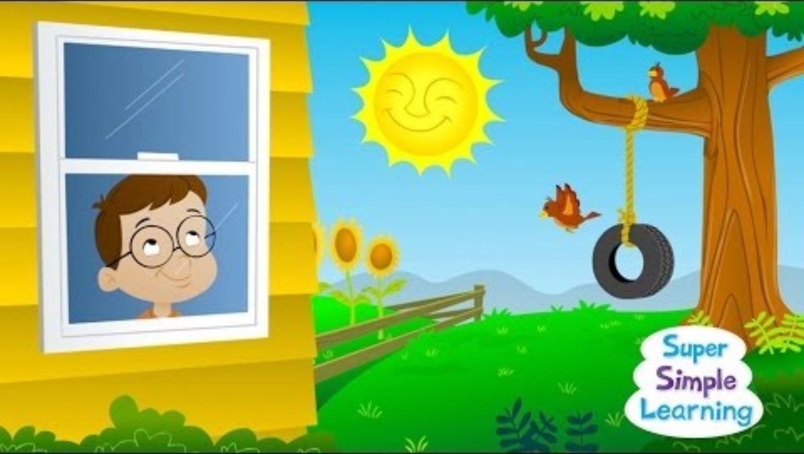

Weather Songs

Slide 13
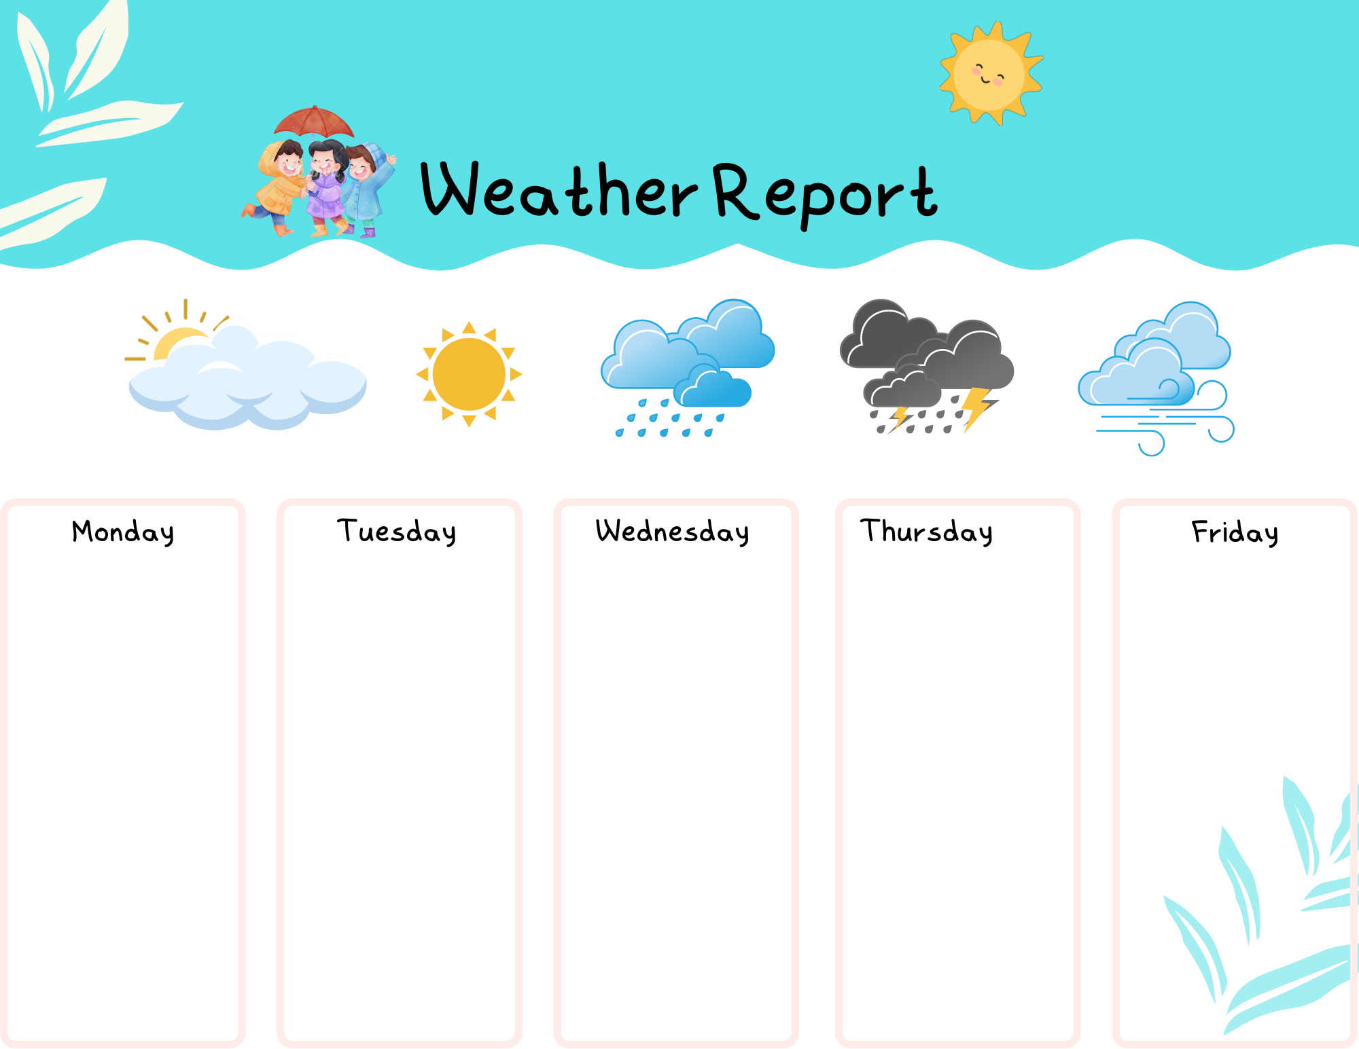







Slide 14

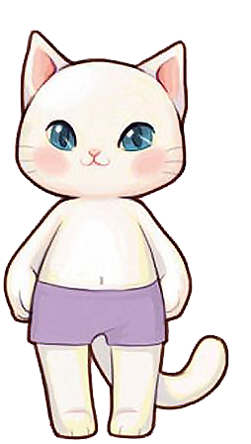


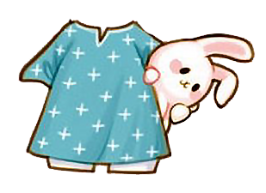
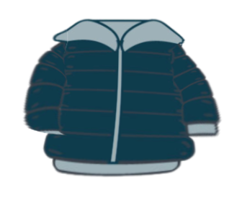


Slide 15
Gonoodle Mooderators

Slide 16



Slide 25
Math:
Counting from 1-20 without help
Identifying each number
ELA:
CVC words
Identifying each word in a sentence.
Reading a sentence.
Signs of your community
Basic ASL words to help with communications.

Slide 26

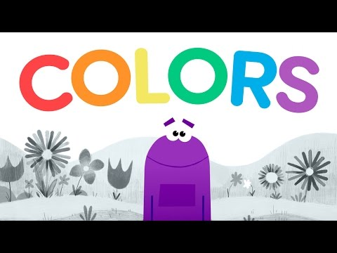

Slide 27

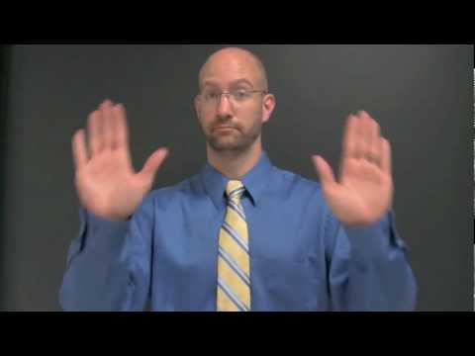
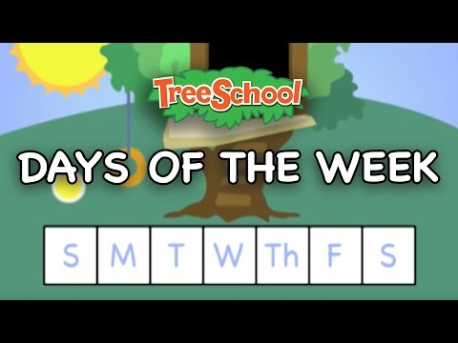
Days of the Week ASL

Slide 28
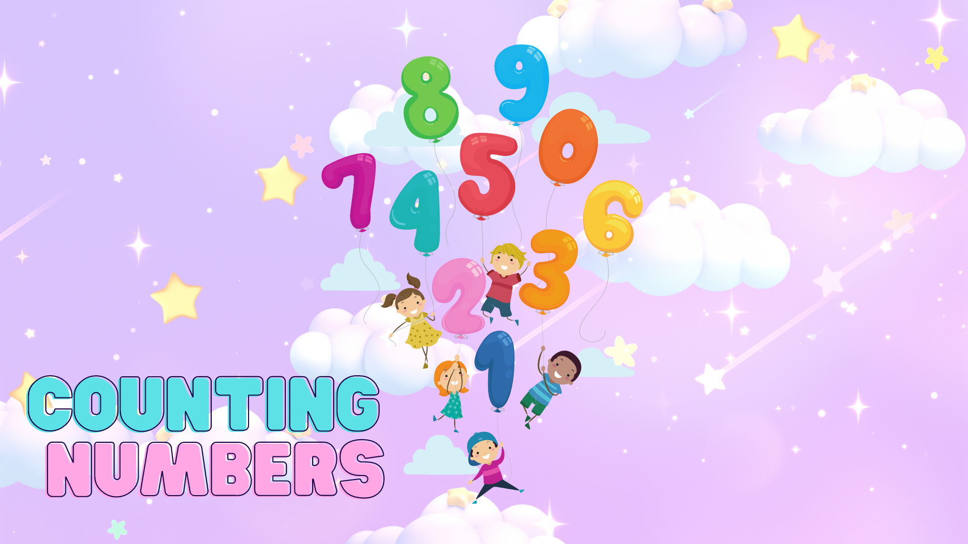

Slide 29

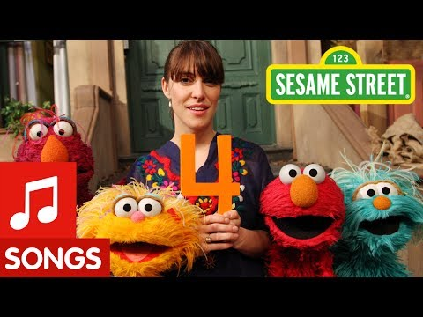
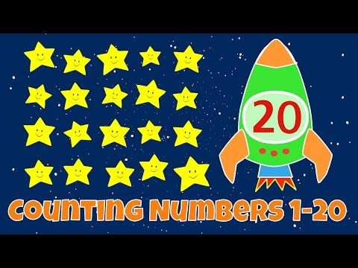
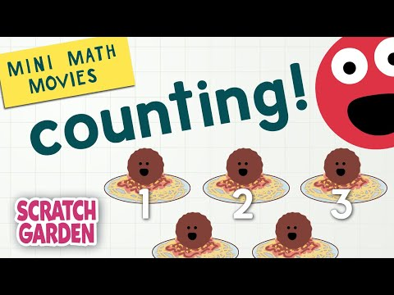

Slide 30
1 2 3 4 5

Slide 31
6 7 8 9 10

Slide 32
11 12 13

Slide 33
14 15 16

Slide 34
17 18 19 20

Slide 35
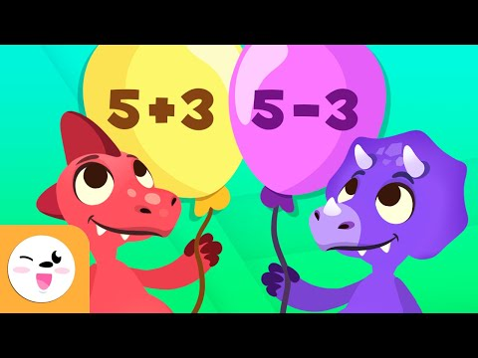
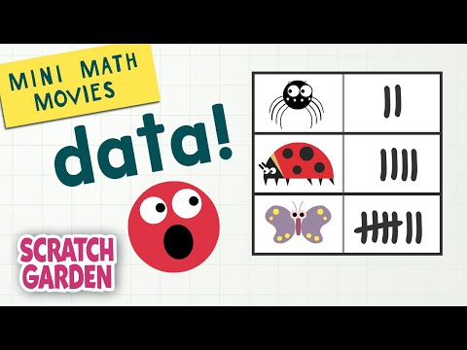
Adding/Subtracting

Slide 36
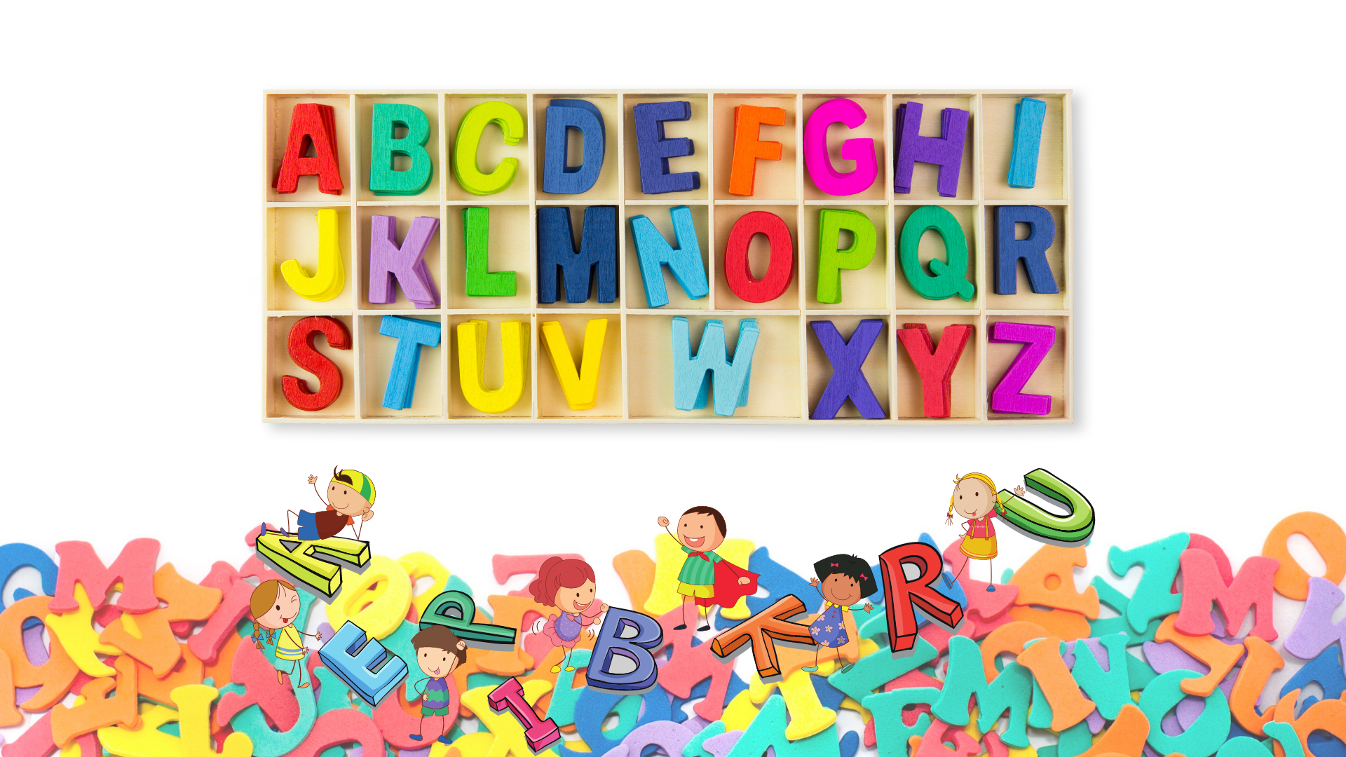

Slide 37

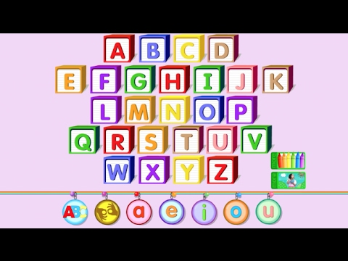
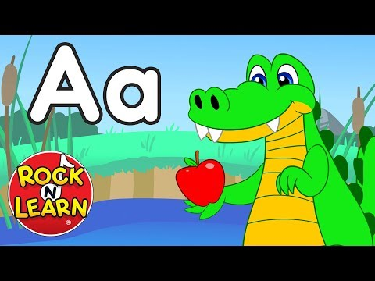
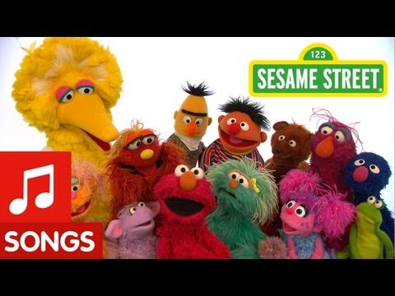
ABC's

Slide 38


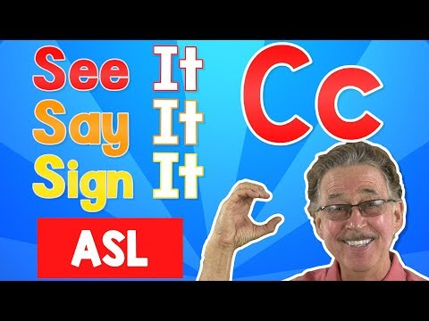












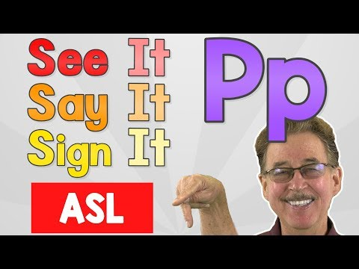











Slide 39
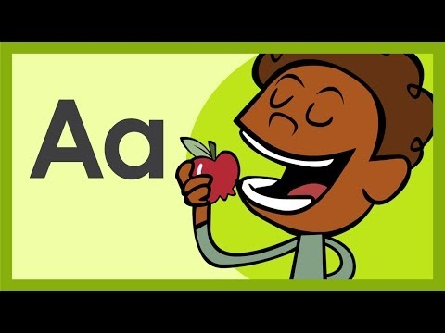
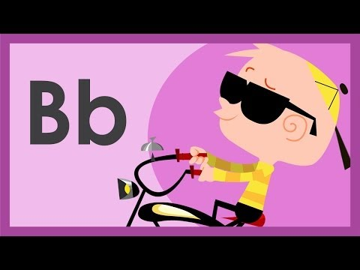
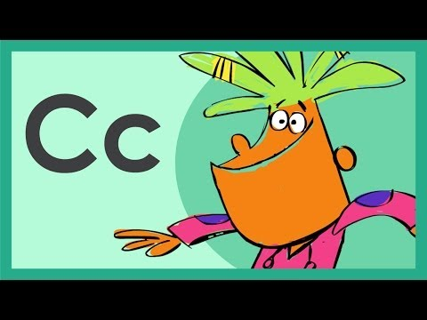

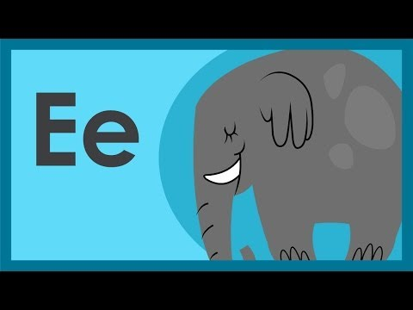

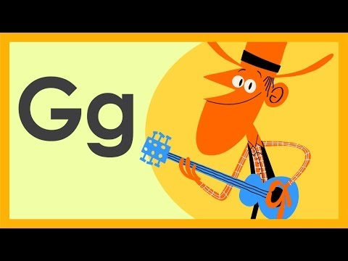





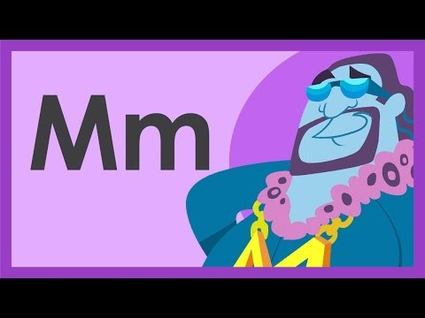

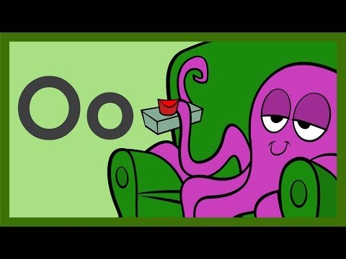

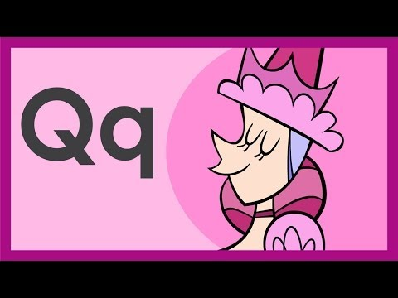










Slide 40
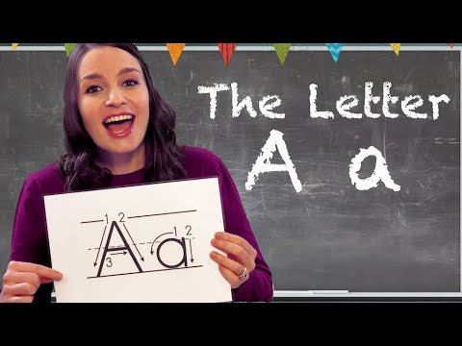
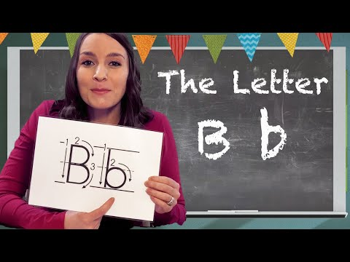
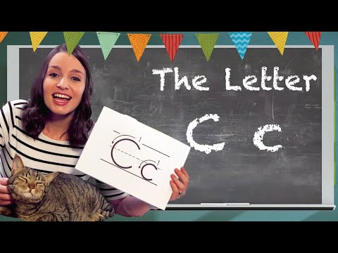
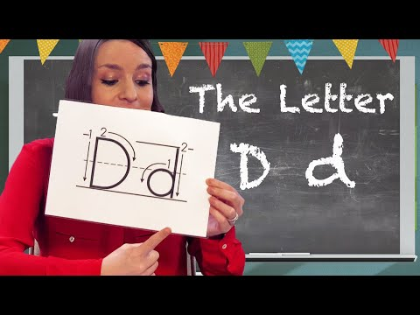
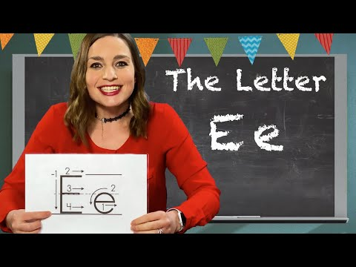
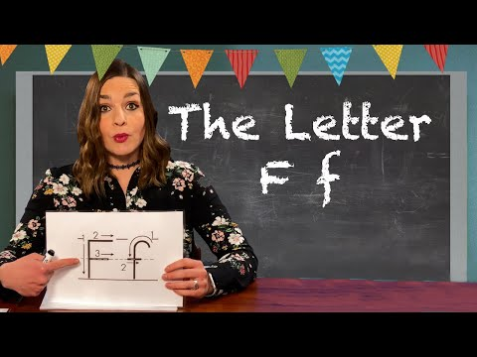

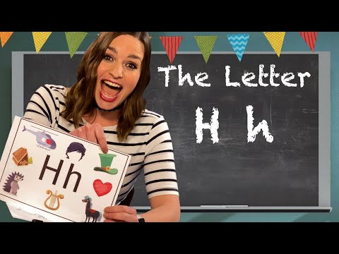
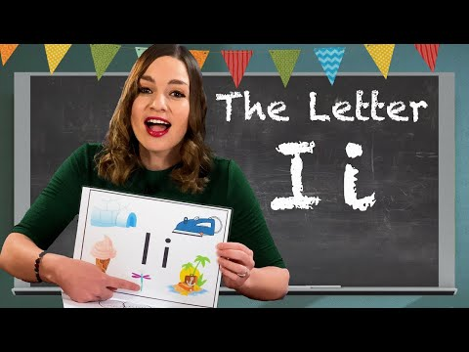
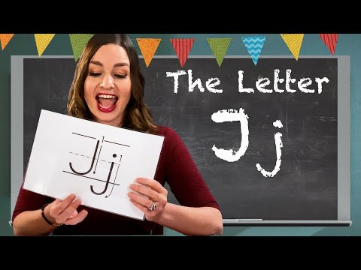
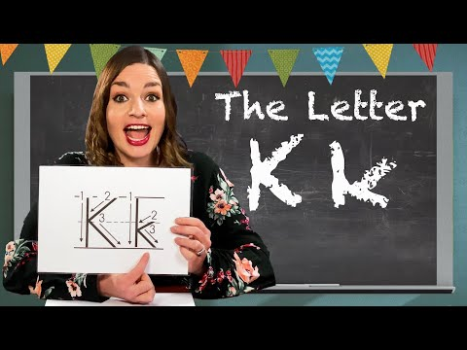

Slide 41


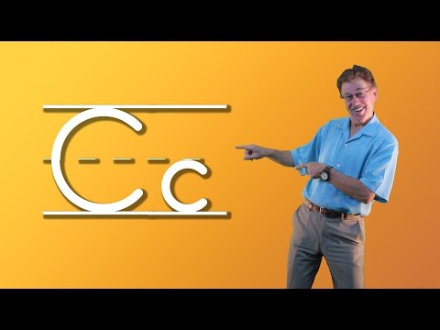

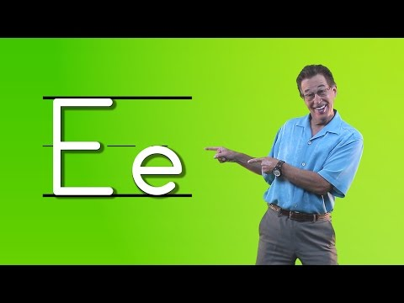
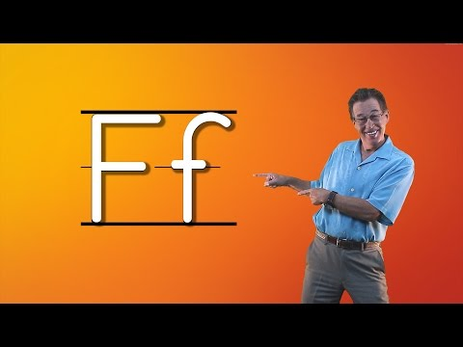
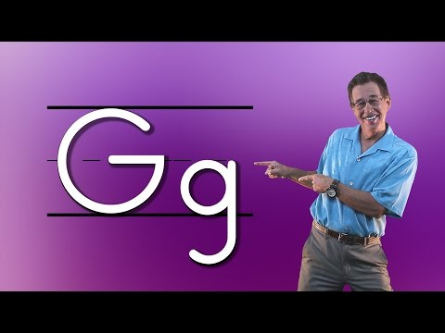





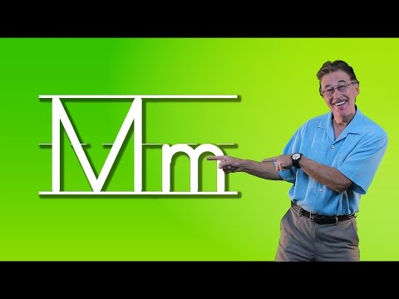
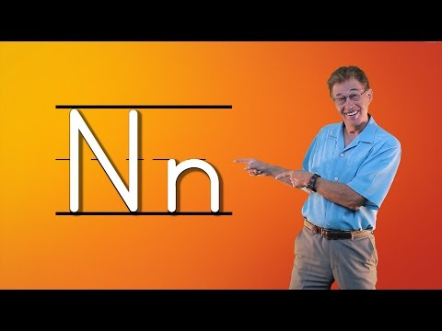













Slide 42



























Slide 43


CVC

Slide 44

Sight Words
Sight Words Song | Gracie’s Corner | Kids Songs + Nursery Rhymes - YouTube

Slide 45


Slide 46




Shapes

Slide 47


Slide 48


Slide 49



Slide 50


https://www.youtube.com/live/4jrnb13DeTM?si=egJSLjHnPWzseh5T

Slide 51



Slide 52



Slide 53


Sentences

Slide 54


Slide 55


Slide 56


Slide 57



Safety Signs

Slide 58



Crossing the street

Slide 59



Safety Signs

Slide 60

Cleaning the kitchen

Slide 61








History
Part 1
Part 2
Part 3

Slide 62




Art/Projects

Slide 63







Science

Slide 64














Slide 65














Slide 66











Slide 67














Slide 68









Dance Music
1
2
3
4
5
6
7
8
9

Slide 71


End of the Day!!

